Slide 1
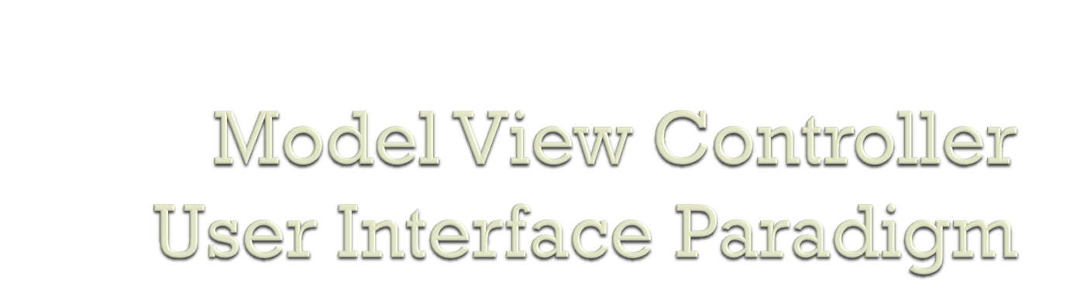
presented by Benjamin Kehrer
[CSCI 360, CofC, 03/17/08]

Slide 2

References
General Information
Operation breakdown
Ad- / Disadvantages
Java

Slide 3

A Description of the Model-View-Controller User Interface Paradigm in the Smalltalk-80 System
[Krasner, Pope 1988]
Model-View-Controller (MVC) Architecture
[Deacon, 2005]
Java Blue Prints – Model-View Controller
[Sun Microsystem, 2000-2002]
Introduction to Software Engineering Design – Ch.15
[Fox, 2007]

Slide 4


Design pattern
Developed by Trygve Reenskaug in 1979
Originally for Smalltalk-80
Paradigm / metaphor / pattern
/ architecture / idiom

Slide 5


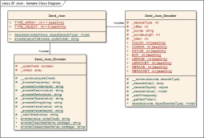
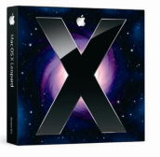
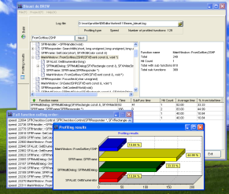
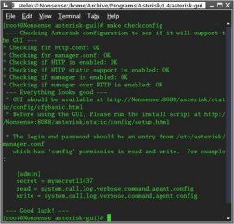
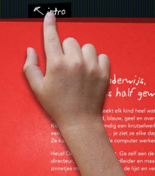

Business model
Model
Application domain
Knows about
Knows about
1
1
n
n
User Interface
View
Presentation
Controller
Control logic &
user interaction
Knows about
1
1

Slide 6



Business model
Model
Application domain
Model Access
Model Access
Change
Event
Change
Event
User Interface
View
Presentation
Controller
Control logic &
user interaction
View Access

Slide 7

Modularity:
Decoupling of user interface & business model
Changeability, Maintainability:
Easier to understand & modify
Pluggability, Flexibility:
Change UI (even during runtime)
Increased performance due to slow update
Dependance on models
Separation View & Controller

Slide 8

View & Controller combined to “ViewController“ or “Delegate“
Controller limited to interface between Model & View

Slide 9
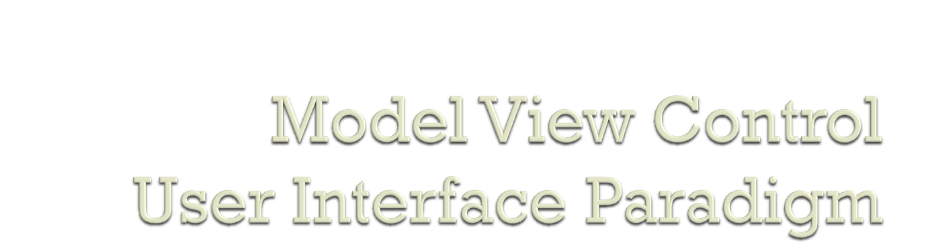
Thanks for your attention.

